Slide 1
50ug L929 s20
3ng cGAS

Slide 3
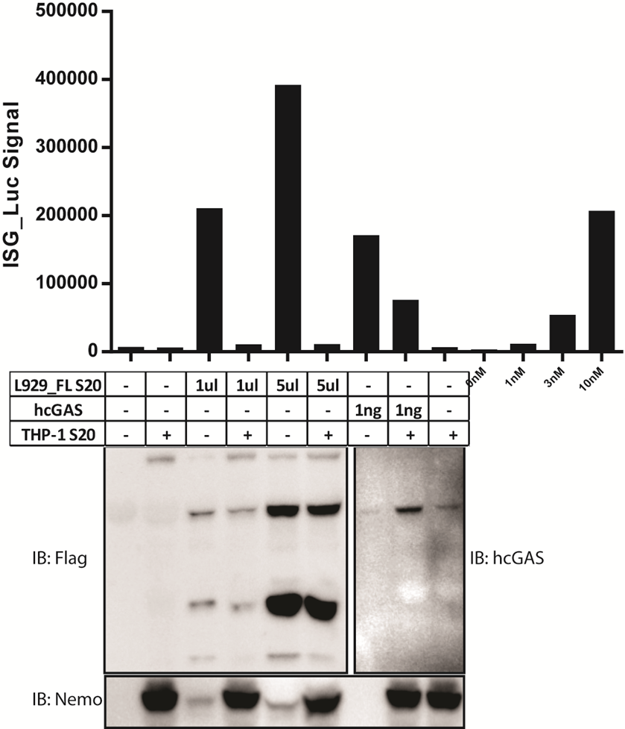
To further confirm that the inhibitory effect in THP-1 S20 is not due to protease degradation of cGAS protein

Slide 4
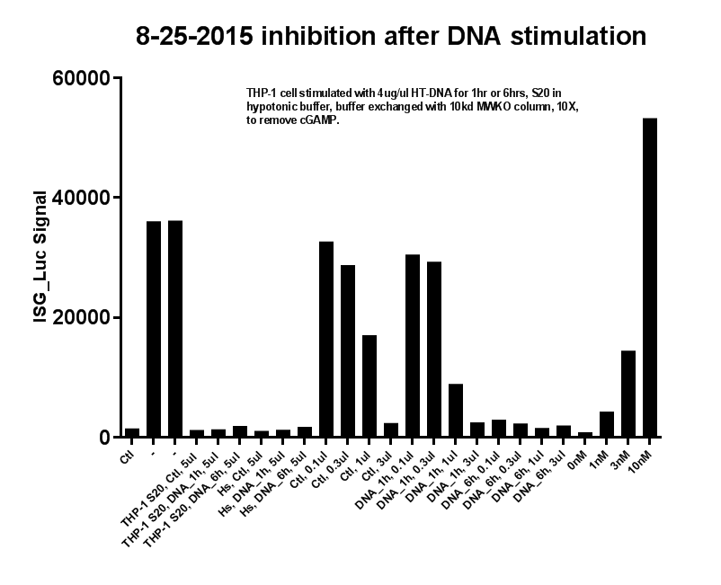
DNA stimulation test

Slide 5
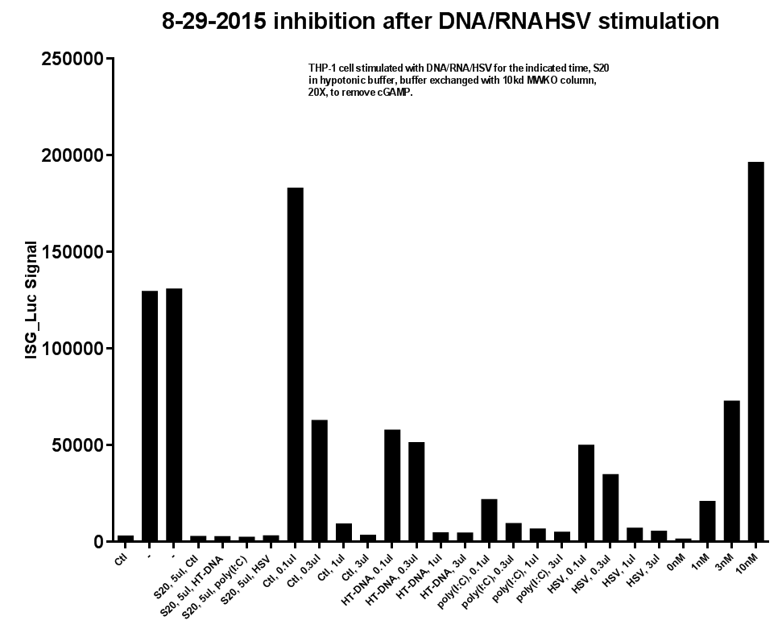
DNA stimulation test

Slide 6
8-29-2015 inhibition after DNA/RNAHSV stimulation
Notes:
THP-1 cell stimulated with DNA/RNA/HSV for the indicated time, S20 in hypotonic buffer, buffer exchanged with 10kd MWKO column, 20X, to remove cGAMP.

Slide 7
Column Summary Table
 | Activity | Yield | Fold | Note
40% AmSO₄ cut | About half in sup, half in pellet | ~50% | 3-4x | Use
Mono S | FT |  | ~1x | Not use
HiTrap Q HP | Bind | ~100% | ~5x | Good
Mono Q | ~70%B | 30% | 15x | Good
Superose 6 | Void Volumn | 80% | 4x | Use
Phenyl | FT | ~60% | 1.5x | Not use
Blue | FT and 25%B | 30% | ~4x | Use
CHT | 50%B and 100%B | 15-20% | 50x | Good
Octyl | FT | 20% | 2x | Not use
cGAS affinity | FT | 70% | ? | Not use
ANX FF | 100%B | ~100% | ? | Not use
Q FF | 100%B | ~100% | ? | Not use
Heparin HP | FT | ? | ? | Not use
Glycerol Gradient (10%~50%) | Bottom | ? | ? | -
Notes:
4% highly cross-linked agarose instead of 6%

Slide 9
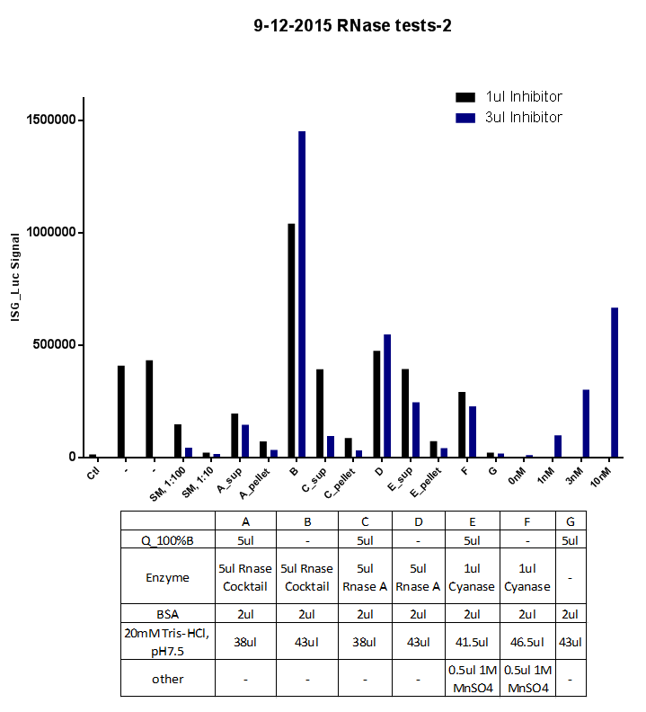
RNase cocktail, RNase A or Cyanase can kill 80% of the inhibitor activity and the majority of the remaining activity is in the pellets.

Slide 11
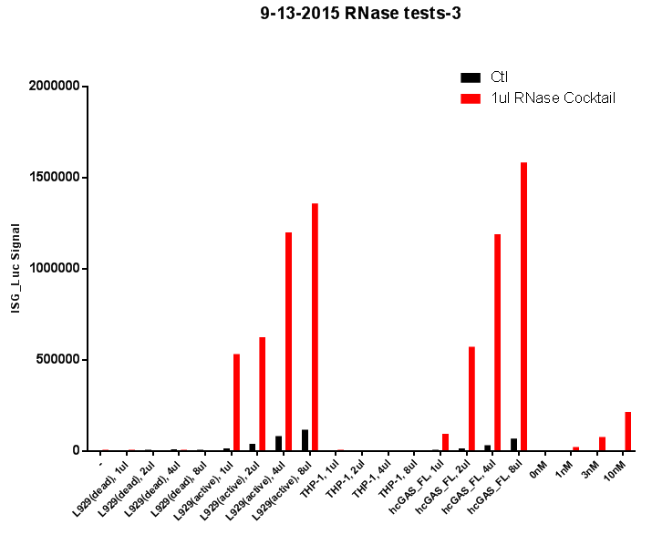
RNase treatment can enhance cGAS activity

Slide 13
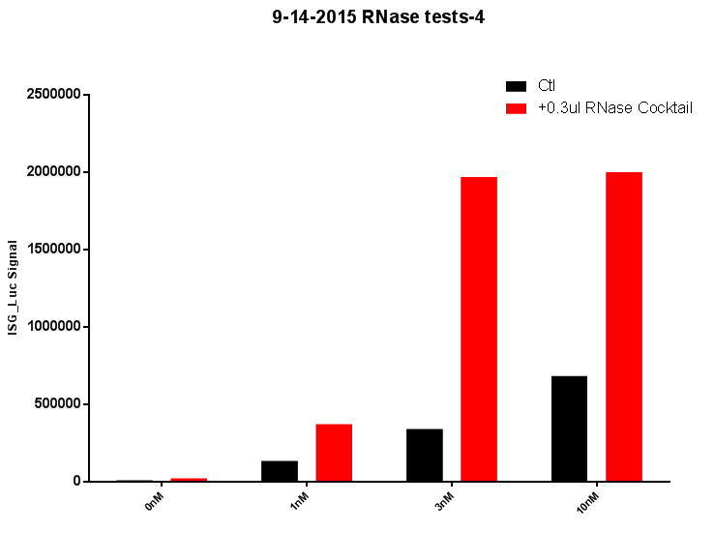
RNase can facilitate the delivery of cGAMP?

Slide 14
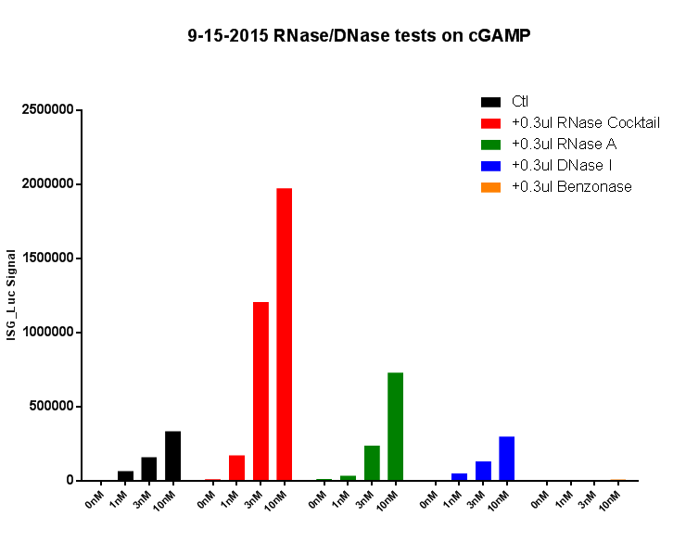

Slide 15
RNA can inhibit cGAS activity
Total RNA extracted from THP-1 cell S20 (Ctl and SeV stimulated) can inhibit cGAS activity in L929 S20.

Slide 16
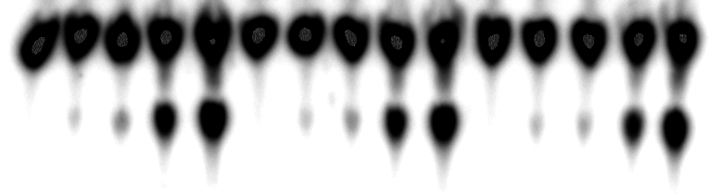
cGAS and DNA titration test
hcGAS_FL
(ng)
0
1.2
3.6
12
36
0
1.2
3.6
12
36
0
1.2
3.6
12
36
0.1ug HT-DNA
0.3ug HT-DNA
1.0ug HT-DNA
Mix1(10ul x n):
10x Buffer: 1.5ul x n
BSA: 0.15ul x n
H2O
Mix2(2ul x n):
DNA: 1ul x n
10mM GTP: 0.3ul x n
0.3mM ATP: 0.15 x n
H2O
*ATP: 0.05 x n
9-17-2015

Slide 17
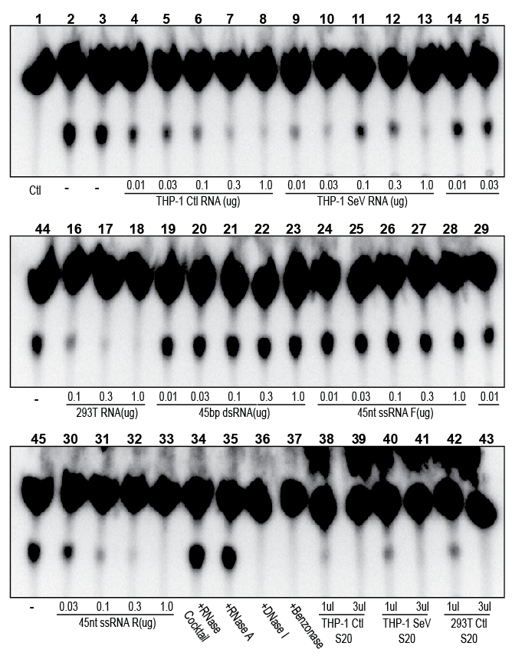
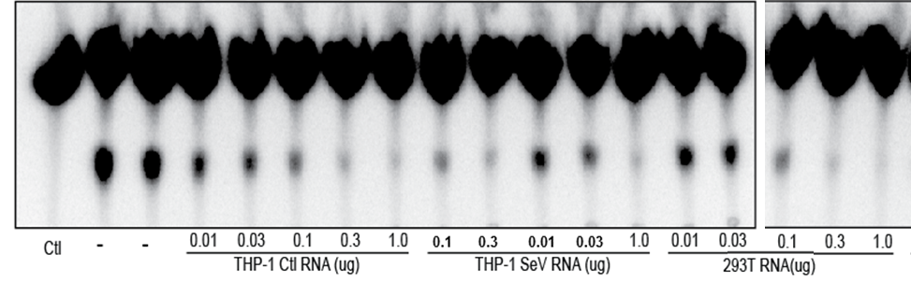
15µL reaction:
12ng hcGAS_FL
0.1µg HT-DNA
200µM GTP
3µM ATP (cold)
0.05µL *ATP(hot)
9-18-2015

Slide 18
15µL reaction:
12ng hcGAS_FL
0.1µg HT-DNA
200µM GTP
3µM ATP (cold)
0.05µL *ATP(hot)
9-18-2015

Slide 19
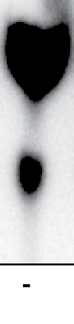
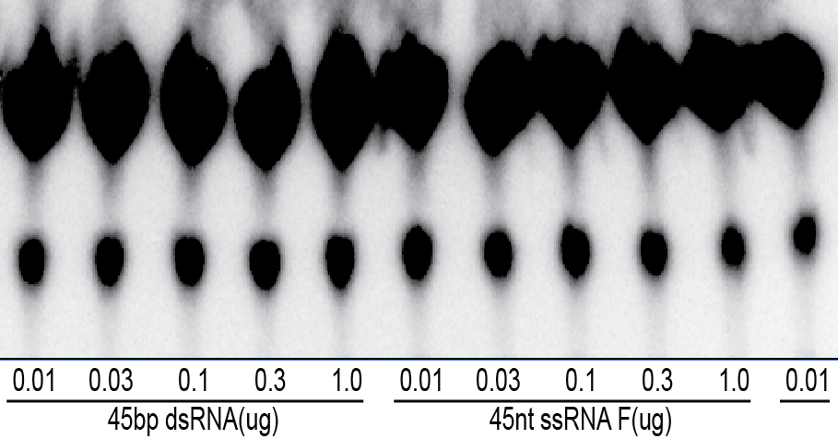
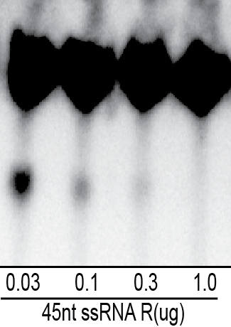
3. Characterization and purification of cGAS inhibitor(s)
Synthetic ssRNA have potent cGAS inhibitory effect
Inorganic
phosphate
cGAMP
45nt ssRNA F: AAACAAAAACAAAACAAACAACACAACAAACAAAACAAAAACAAA
45nt ssRNA R: UUUGUUUUUGUUUUGUUUGUUGUGUUGUUUGUUUUGUUUUUGUUU
45bp dsRNA: annealed from 45nt ssRNA F&R
Notes:
Synthetic ssDNAs do NOT inhibit cGAS activity

Slide 20
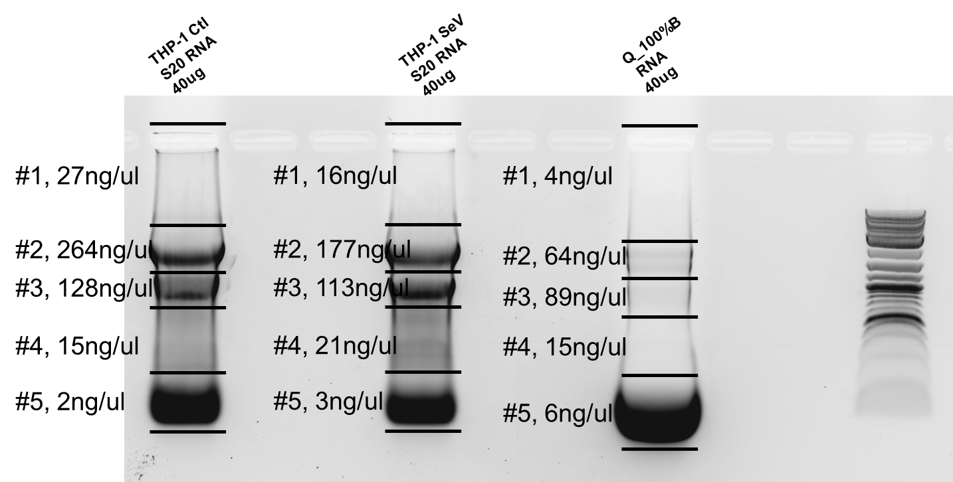
RNA fractionation by 1% agarose gel

Slide 21
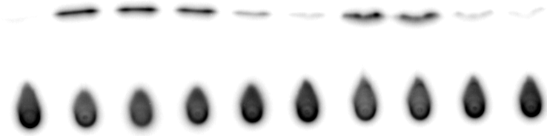
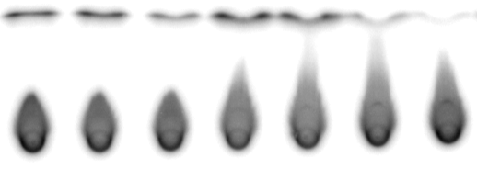
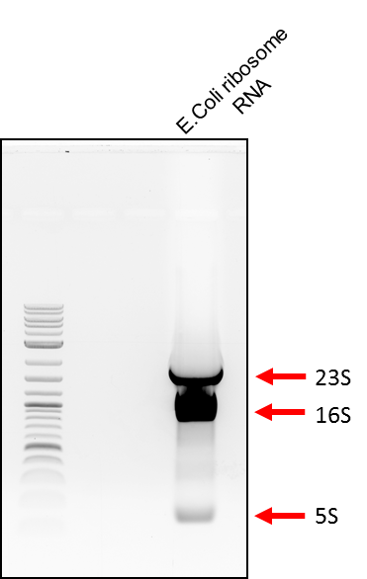
3. Characterization and purification of cGAS inhibitor(s)
16S and 23S E.coli rRNA can potently inhibits cGAS
23S E.coli Ribosome RNA
(2900nt) (ng)
16S E.coli Ribosome RNA
(1500nt) (ng)
5S E.coli Ribosome RNA (ng)
E.coli Ribosome RNA
(ng)
Ctl
-
1
3
10
30
1
3
10
30
1
3
10
1
3
10
30
cGAMP
cGAS: 30nM
ISD: 220nM (0.2ug)

Slide 22
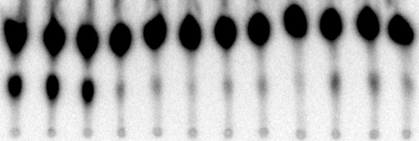
THP-1 Ctl S20 RNA (ug)
THP-1 SeV S20 RNA (ug)
Q_100%B
RNA (ug)
-
-
-
0.03
0.1
0.3
0.03
0.1
0.3
0.03
0.1
0.3

Slide 23
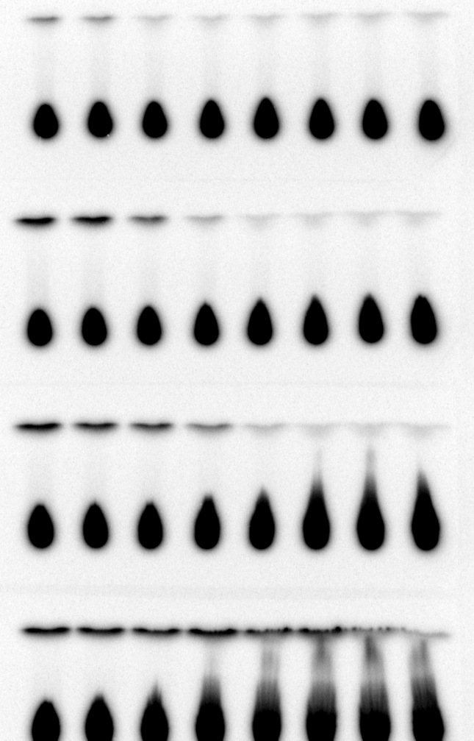
45nt ssRNA
(ng):
1
3
10
30
100
300
1000
3000
45nt ssRNA R @
10ng ISD
45nt ssRNA R @
100ng ISD
45nt ssRNA R @
1000ng ISD
45nt ssRNA F @
100ng ISD

Slide 24
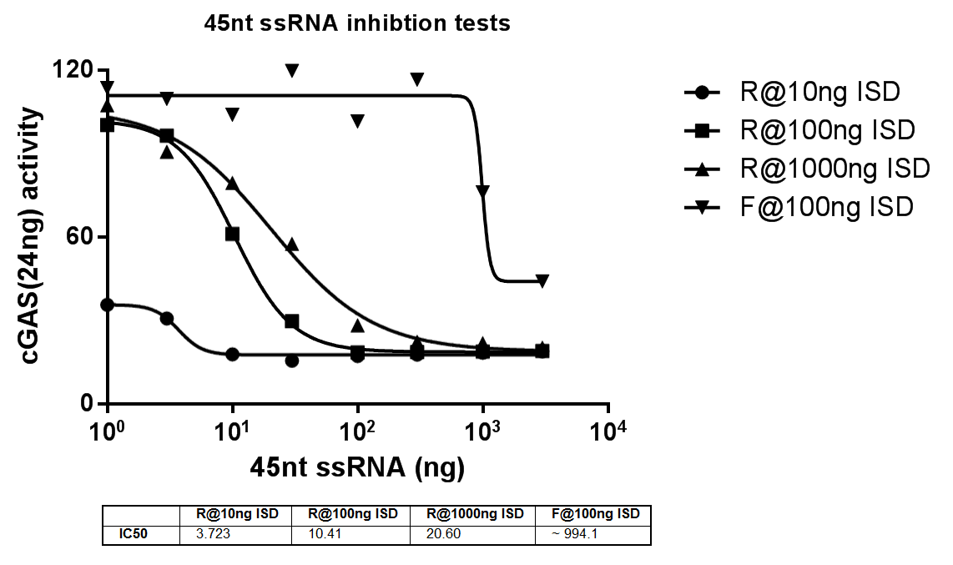
~25nM
~250nM
~2.5uM
~30nM
~50nM

Slide 25
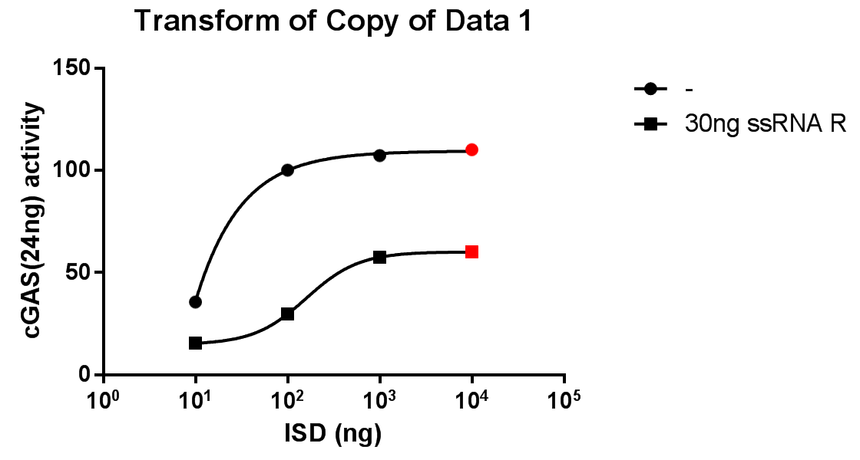
Saturated dose of ISD
Non-competitive inhition

Slide 26
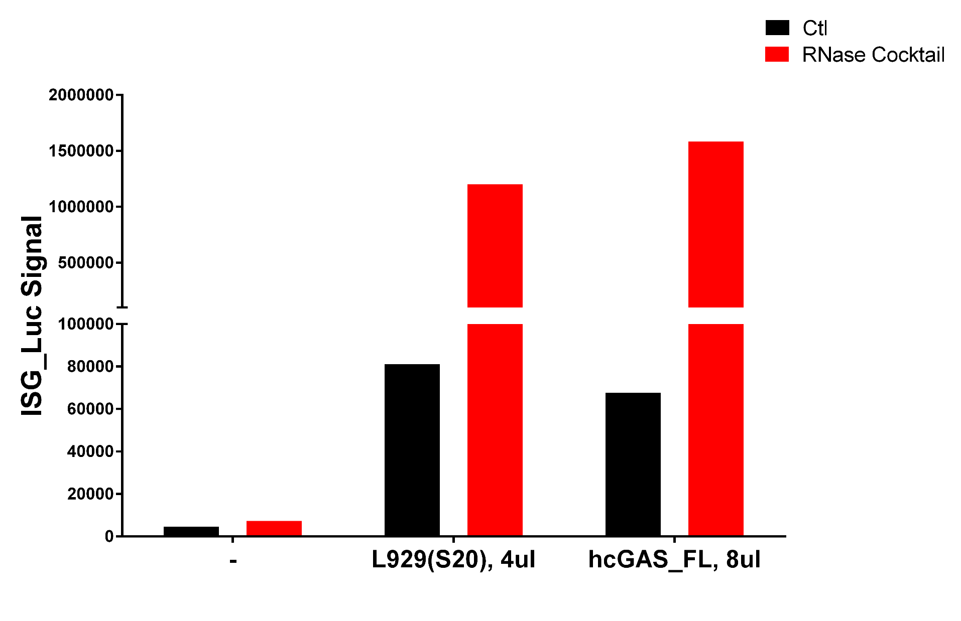
RNase can significantly enhance cGAS activity
23x folds
15x folds
Previous data

Slide 27
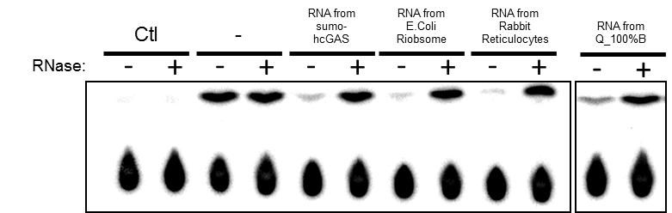
Inhibition of cGAS by RNA can be abolished by RNase
In all groups, 30ng of RNA was used; RNase used here is the RNase cocktail; For all reactions, 25ng cGAS with 100ng ISD is used in 15ul reaction.

Slide 28
Properties of putative cGAS inhibitor (from previous work)
Bind to Q and CHT column quite well
It’s very big/heavy complex (eluted in void volume on gel filtrations, major activity in P100, or in the bottom fraction of glycerol/sucrose gradient centrifugation)
Heat sensitive (95 degree, 5min would kill the activity)
It “changes” after Benzonase treatment (molecular weight becomes smaller but with very low recovery)
RNase treatment kills 90% of the inhibitory activity in Q_100%B
RNase treatment kills 70% of the inhibitory activity in S20, 90% of the remaining activity is in the pellet fraction.
RNase increase the activity of recombinant cGAS and also cGAS in L929 S20 (the effect is much more significant for L929 S20, a. more RNA binds to cGAS in S20; b. much less cGAS protein in L929 S20; c. Detection method, RNase increase the response of cells to cGAMP delivery)
RNA extracted from 293T, L929 and THP-1 cells can potently inhibit cGAS activity
Inhibitory effect from RNA is not heat sensitive

Slide 29
Sequence specificity of inhibitory ssRNA

Slide 30
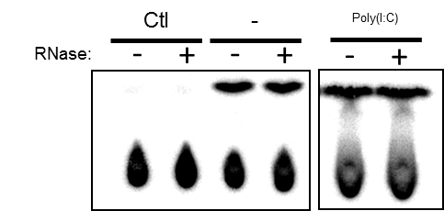
Synthetic ssRNA have potent cGAS inhibitory effect
Inorganic
phosphate
cGAMP
45nt ssRNA F: AAACAAAAACAAAACAAACAACACAACAAACAAAACAAAAACAAA
45nt ssRNA R: UUUGUUUUUGUUUUGUUUGUUGUGUUGUUUGUUUUGUUUUUGUUU
45bp dsRNA: annealed from 45nt ssRNA F&R

Slide 31
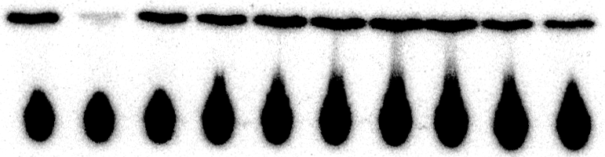
Synthetic ssDNAs do NOT inhibit cGAS activity
@24ng hcGAS w/ 100ng ISD
25nt ssDNA F (ng)
25nt ssDNA R (ng)
45nt ssDNA F (ng)
45nt ssDNA R (ng)
-
45nt ssRNA R
30ng
30
60
30
60
30
60
30
60
25nt ssDNA F: AAACAAAAACAAAACAAACAACACA
25nt ssDNA R: TTTGTTTTTGTTTTGTTTGTTGTGT
45nt ssDNA F: AAACAAAAACAAAACAAACAACACAACAAACAAAACAAAAACAAA
45nt ssDNA R: TTTGTTTTTGTTTTGTTTGTTGTGTTGTTTGTTTTGTTTTTGTTT

Slide 32

Shorter version of ssRNA R does NOT inhibit cGAS
@24ng hcGAS w/ 100ng ISD
35nt ssRNA R_1(ng)
35nt ssRNA R_2(ng)
35nt ssRNA R_3(ng)
35nt ssRNA R_4(ng)
-
45nt ssRNA R
30ng
30
60
30
60
30
60
30
60
45nt ssRNA R | UUUGUUUUUGUUUUGUUUGUUGUGUUGUUUGUUUUGUUUUUGUUU
35nt ssRNA R_1 | UUUGUUUUUGUUUUGUUUGUUGUGUUGUUUGUUUU
35nt ssRNA R_2 | UUUUGUUUGUUGUGUUGUUUGUUUUGUUUUUGUUU
35nt ssRNA R_3 | UUUUGUUUUGUUUGUUGUGUUGUUUGUUUUGUUUU
35nt ssRNA R_4 | UUUGUUUUGUUUGUGUGUUUUGUUUGUUUUUGUUU

Slide 33
Both 16S and 23S E.coli rRNA inhibits cGAS
23S E.coli Ribosome RNA
(2900nt) (ng)
16S E.coli Ribosome RNA
(1500nt) (ng)
5S E.coli Ribosome RNA (ng)
E.coli Ribosome RNA
(ng)
Ctl
-
1
3
10
30
1
3
10
30
1
3
10
1
3
10
30
0.9nM
1.7nM
cGAS: 30nM
ISD: 220nM

Slide 34
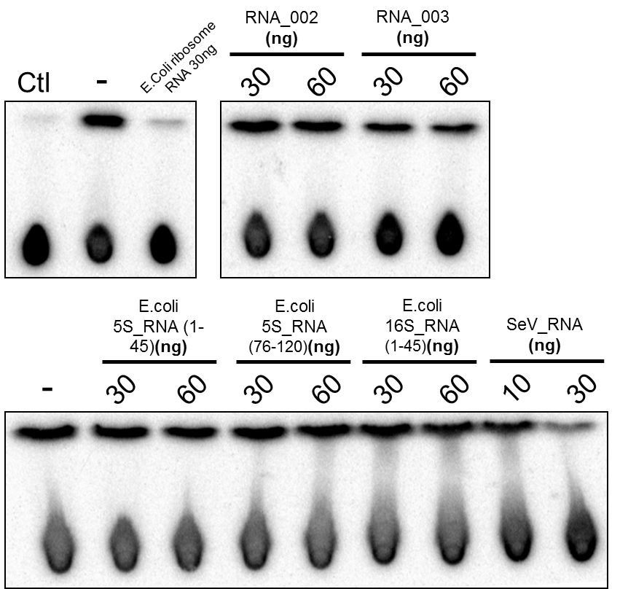
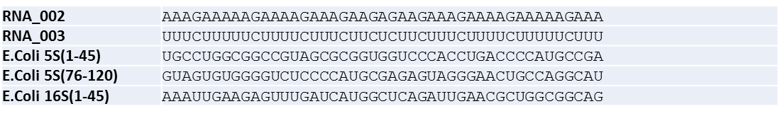
ssRNA inhibits cGAS in sequence dependent manner
Changing U->A
Changing G->C

Slide 35
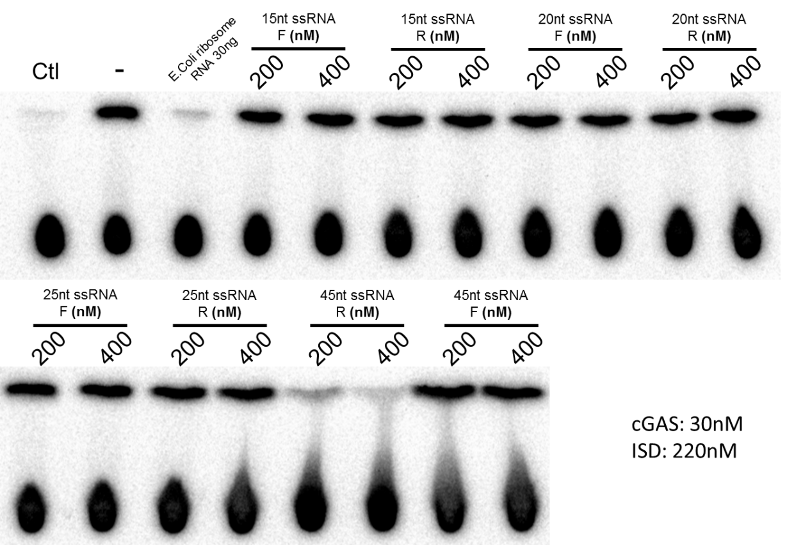
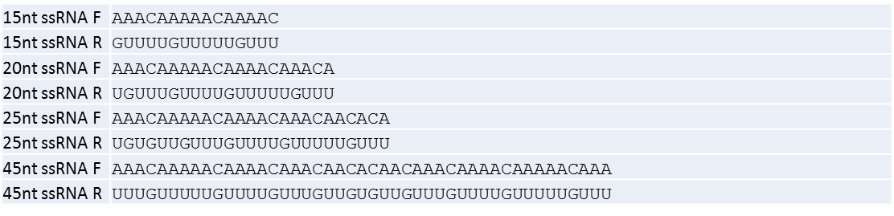
Shorter version of ssRNA R does NOT inhibit cGAS

Slide 36
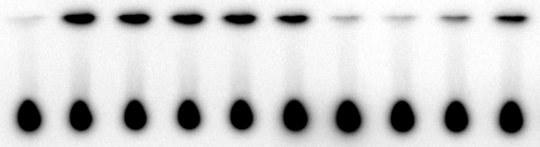
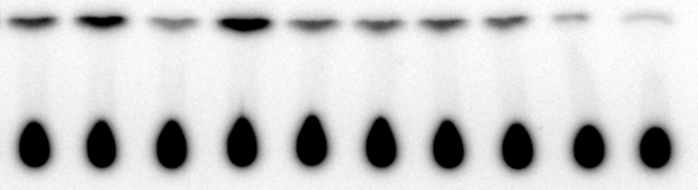
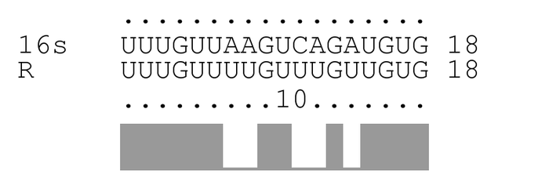
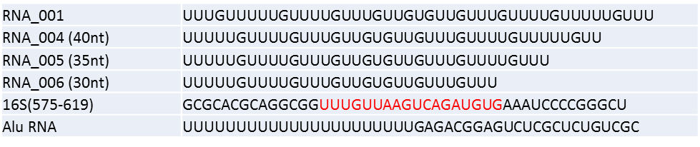
40nt ssRNA R does NOT inhibit cGAS (RNA_004)
E.coli 16S rRNA fragment inhibits cGAS
Ctl
-
RNA_001
RNA_004
16S(575-619)
E.Coli ribosome
RNA 30ng
45nt ssRNA R
RNA_005
RNA_006
Alu_RNA
cGAS: 30nM
ISD: 220nM
Oligo: 400nM

Slide 37
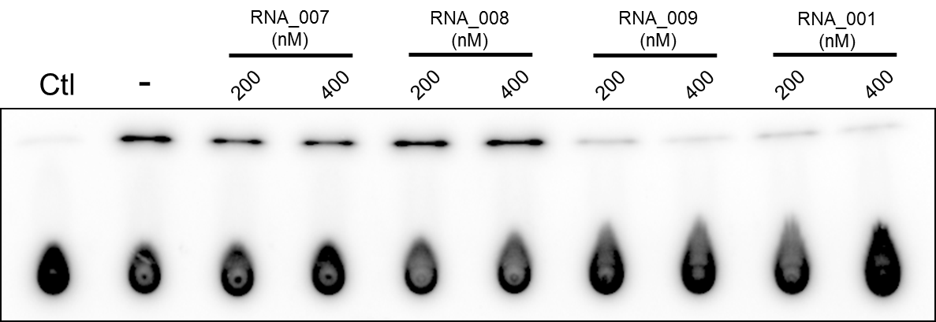
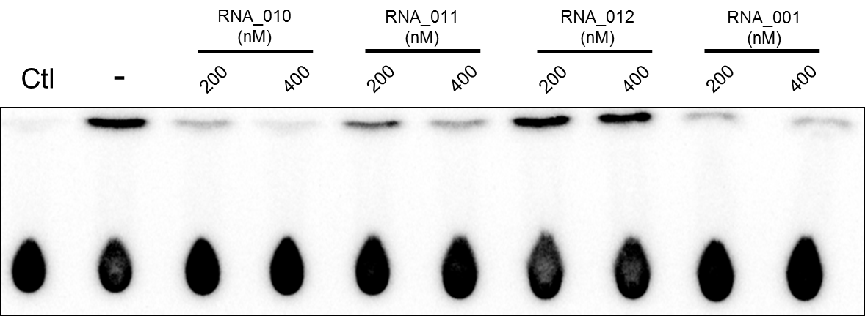
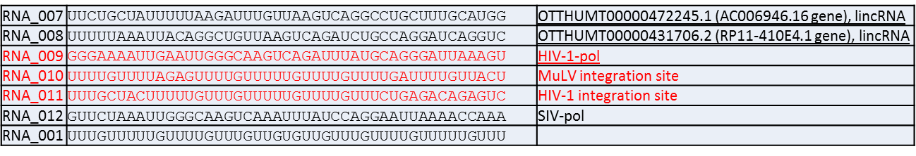
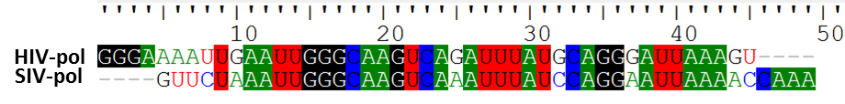
HIV pol CDS fragment inhibits cGAS (but not fragment from SIV)
cGAS: 35nM
ISD: 220nM

Slide 38
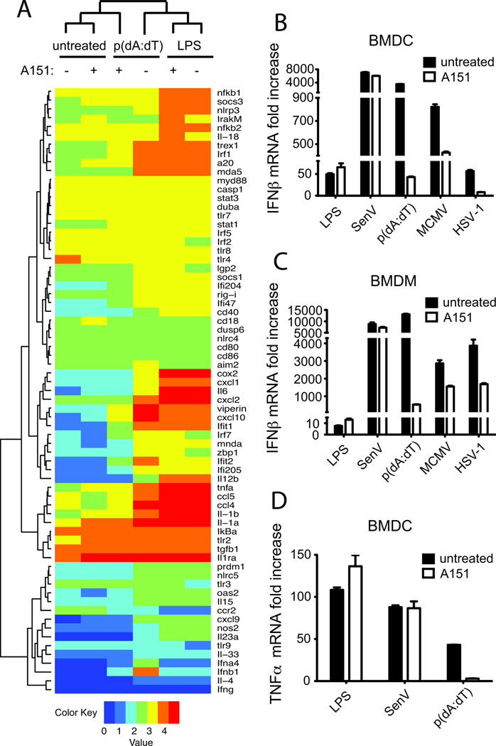
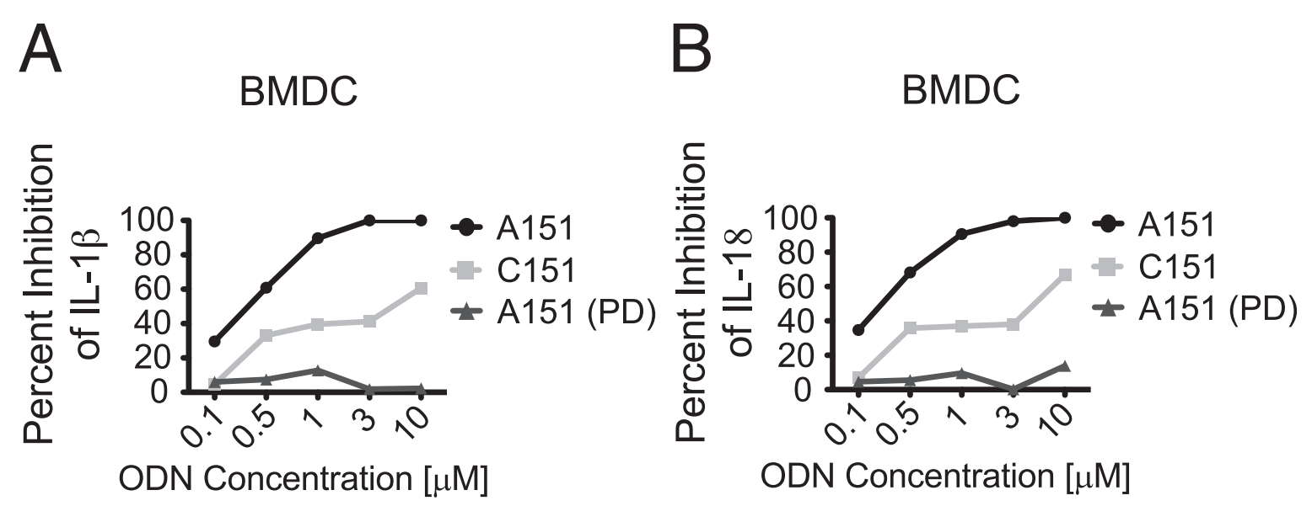
PS-bond DNA inhibits AIM2 pathway
Kaminski, John J., et al. "Synthetic oligodeoxynucleotides containing suppressive TTAGGG motifs inhibit AIM2 inflammasome activation." The Journal of Immunology 191.7 (2013): 3876-3883.

Slide 39
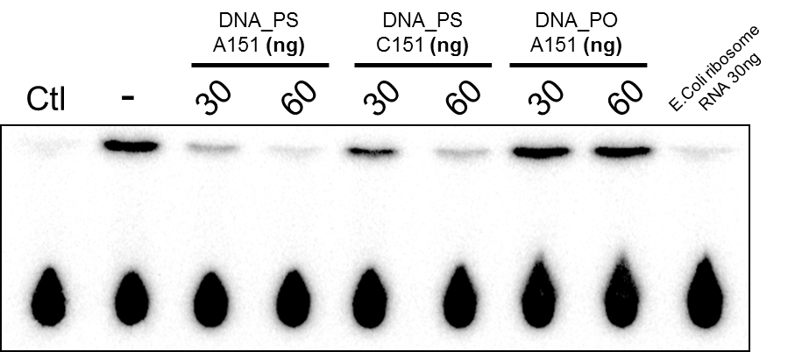
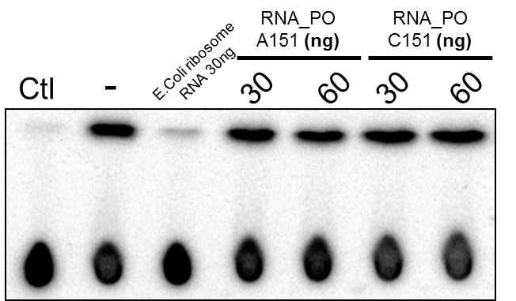
PS ssDNA inhibits cGAS (sequence independent)
DNA_PS_A151 | T*T*A*G*G*G*T*T*A*G*G*G*T*T*A*G*G*G*T*T*A*G*G*G
DNA_PS_C151 | T*T*C*A*A*A*T*T*C*A*A*A*T*T*C*A*A*A*T*T*C*A*A*A
DNA_PO_A151 | TTAGGGTTAGGGTTAGGGTTAGGG
RNA_PO_A151 | UUAGGGUUAGGGUUAGGGUUAGGG
RNA_PO_C151 | UUCAAAUUCAAAUUCAAAUUCAAA
120nM
cGAS: 30nM
ISD: 220nM
Notes:
BMDCs were primed with LPS (200ng/ml) and challenged with 300ng of poly(dA:dT) complexed with lipofectamine 2000 (untreated).

Slide 40
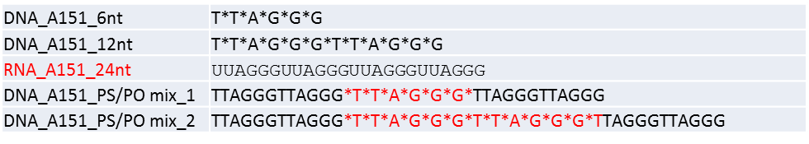
PS bond ssDNA inhibits cGAS (sequence independent)
DNA_A151_PS/PO mix_1
DNA_A151_PS/PO mix_2
-
DNA_A151_6nt
DNA_A151_12nt
RNA_A151_24nt
PS_DNA_AC
Ctl

Slide 41
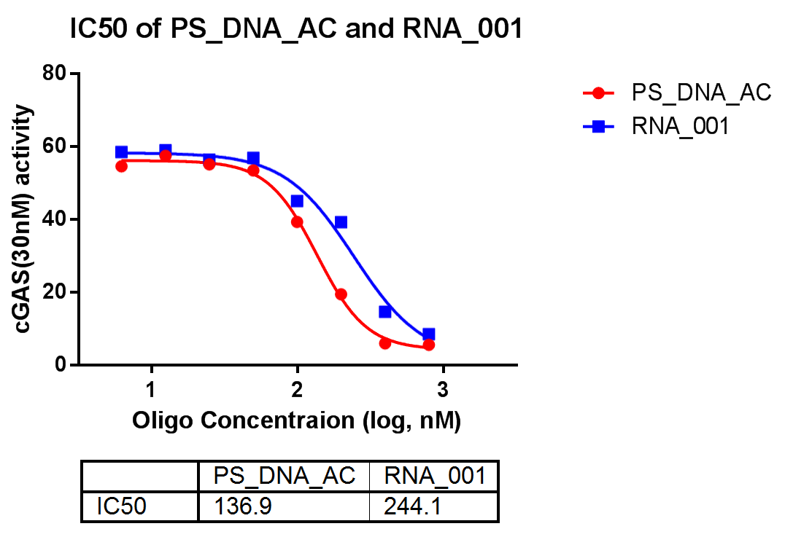
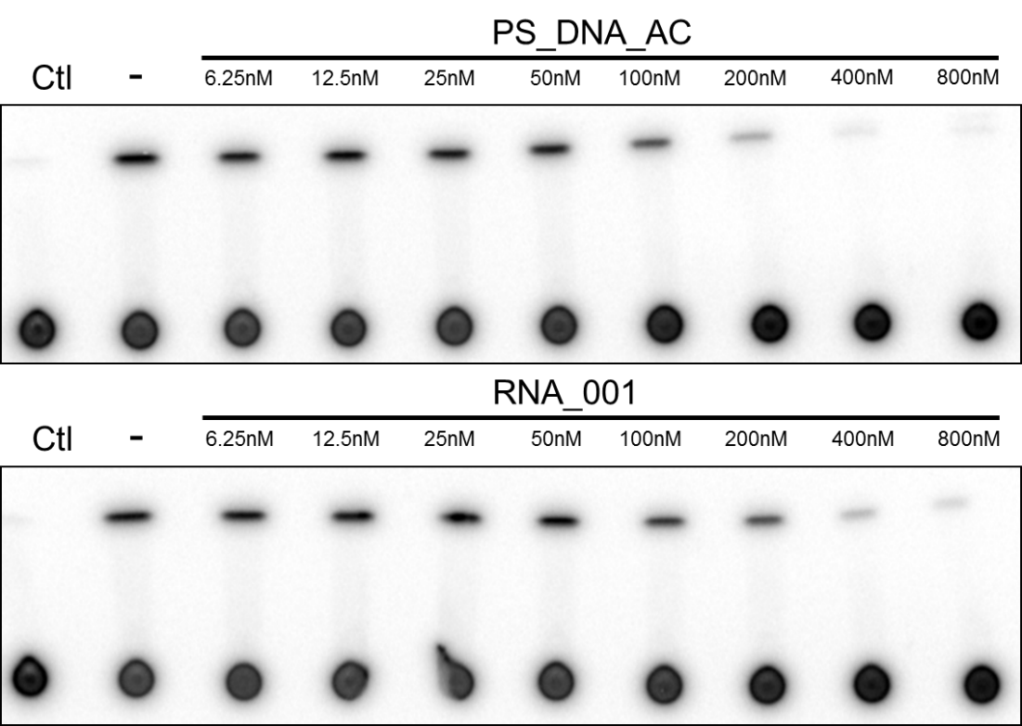
PS_DNA_AC | C*C*C*A*A*A*C*C*C*A*A*A*C*C*C*A*A*A*C*C*C*A*A*A
RNA_001 | UUUGUUUUUGUUUUGUUUGUUGUGUUGUUUGUUUUGUUUUUGUUU
nM
nM
cGAS: 35nM
ISD: 220nM

Slide 42
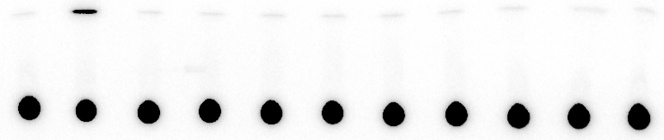
In vitro transcribed HIV genome RNA fragments inhibit cGAS activity
HIV-RNA_
2-4kb (ng)
HIV-RNA_
4-6kb (ng)
HIV-RNA_
6-8kb (ng)
HIV-RNA_
8-end (ng)
RNA_001
400nM
Ctl
-
300
800
300
800
300
800
300
800
DNA templates with T7 promoter were PCR amplified from HIV vector pNL4-3-dE-EGFP
cGAS: 35nM
ISD: 220nM
HIV_RNA:
300ng ~ 30nM

Slide 43
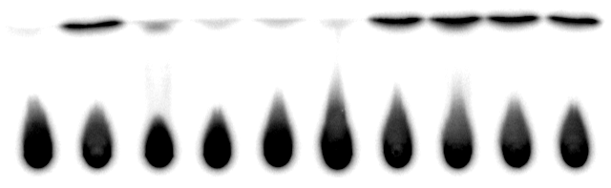
Cas9 mRNA (random mRNA?) inhibits cGAS activity in vitro
RNase -
RNase +
Cas9 mRNA:
(ng)
Ctl
0
100
300
500
Ctl
0
100
300
500
cGAS: 35nM
ISD: 220nM

Slide 44
Oligo Summary
RNA sequence specificity?

Slide 45
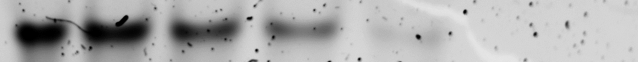
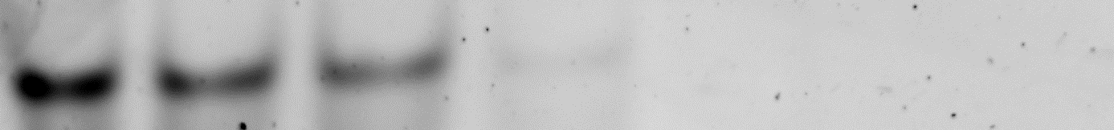
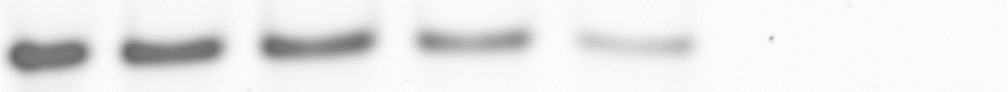
hcGAS_FL:
0
62.5ng
(100nM)
125ng
(200nM)
0.25ug
(400nM)
0.5ug
(800nM)
1ug
(1.6uM)
2ug
(3.2uM)
45nt ssRNA F
60ng (400nM)
45nt ssRNA R
60ng (400nM)
ISD
120ng (400nM)
Both ssRNA F and R bind to cGAS; R strand binds to cGAS more efficiently than F strand and ISD
Previous data

Slide 46
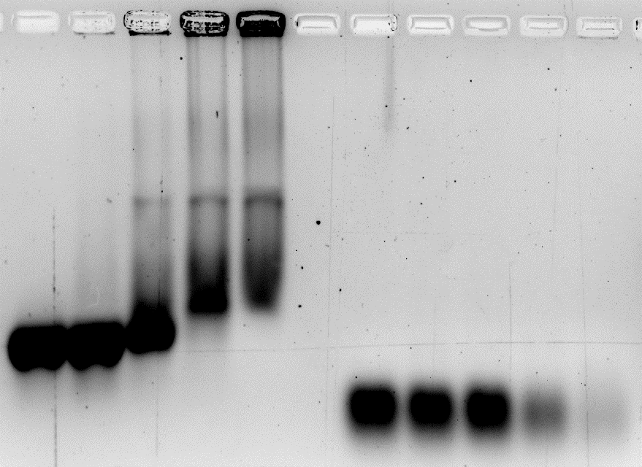

EMSA-4
45nt ssRNA R (4uM)
ISD(1uM)
hcGAS_FL
(uM)
0
1
2
4
8
0
1
2
4
8
Adjusted pic
Adding SYBR gold in the gel; still the sensitivity for RNA is not good enough.
Besides, RNA degrades fast along the running as the running buffer is too basic (40mM Tris-HCl pH9.2, and DNA/RNA runs very slowly in this buffer)
Original pic
Notes:
Also tried adding the dye to the samples, does not work

Slide 47
PS ssDNA inhibits cGAS (sequence independent)
120nM
DNA_PS_A151 | T*T*A*G*G*G*T*T*A*G*G*G*T*T*A*G*G*G*T*T*A*G*G*G
DNA_PS_C151 | T*T*C*A*A*A*T*T*C*A*A*A*T*T*C*A*A*A*T*T*C*A*A*A
DNA_PO_A151 | TTAGGGTTAGGGTTAGGGTTAGGG
RNA_PO_A151 | UUAGGGUUAGGGUUAGGGUUAGGG
RNA_PO_C151 | UUCAAAUUCAAAUUCAAAUUCAAA
cGAS: 30nM
ISD: 220nM
Previous data
Notes:
BMDCs were primed with LPS (200ng/ml) and challenged with 300ng of poly(dA:dT) complexed with lipofectamine 2000 (untreated).

Slide 48




CpG ODN inhibits ISD induced IFNs and IL-6 in cDCs
1uM CpG
2ug/ml ISD

Slide 49
A151 (but not RNA001) inhibits IFNb and CXCL10 production in response to DNA and RNA in THP-1 macrophages (not in undifferentiated cells)
THP-1 PMA differentiated cells were pre-treated with A151 or RNA_001 (2uM) for 2 hours, and then treated with HT-DNA or poly(I:C) for 4 hours
As the Ct for GAPDH in A151 group is significant larger than other groups (a difference of 5), RP23A is used as internal reference.

Slide 50
A151 and CpG-C inhibits IFNb and CXCL10 production in response to DNA and RNA in THP-1 macrophages
THP-1 PMA differentiated cells were pre-treated with A151 or CpG-C (2uM) for 2 hours, and then treated with LPS, HT-DNA or poly(I:C) for 4 hours

